Slide 1
Project Presentation of Industry Oriented Hands on Experience (22CS422)
On
BillDex
(Billing & Inventory Management System)
Ansh Arora
2210991290
Supervised By
Dr. Gurpreet Singh
Department of Computer Science and Engineering,
Chitkara University, Punjab

Slide 2
Content
Introduction
Problem Statement
Objective
Key Features
Technology Stack
System Architecture
Project Snapshots
Conclusion
Future Scope
References/Links used
2

Slide 3
Introduction
Billdex is a modern web-based billing and inventory management system designed to simplify daily business operations for small and medium-sized shops. While many businesses still depend on manual billing methods or scattered tools, Billdex provides a centralized digital platform to handle billing, product records, and stock management efficiently.
From secure user login and organization-based access to product categorization, inventory tracking, and smart bill generation, Billdex streamlines the complete sales process. It automatically updates stock after each transaction, maintains sales history, and helps business owners monitor operations with ease. With a clean dashboard interface and user-friendly workflow, Billdex enables businesses to save time, reduce errors, and manage their stores in a smarter and more organized way.
3

Slide 4
Problem Statement
Managing billing and inventory operations can be challenging for small and medium-scale businesses due to the use of manual methods or disconnected tools. These traditional systems often create delays, errors, and poor visibility in daily operations.
Businesses commonly struggle with:
Manual Billing Errors: Mistakes in invoice creation, pricing, and transaction records.
Inaccurate Stock Management: Difficulty in tracking available inventory and updating quantities after sales.
Lack of Sales Monitoring: No proper system to maintain transaction history or analyze business performance.
Unorganized Operations: Using separate methods for billing and inventory leads to confusion and reduced efficiency.
Limited Digital Access: Many existing software solutions are costly, complex, or not suitable for small business needs.
4

Slide 5
Objective
Billdex aims to simplify and modernize billing and inventory operations for small and medium-scale businesses by providing a centralized and easy-to-use web-based platform. The system helps users:
Automate Billing Processes: Generate accurate invoices quickly and reduce manual calculation errors.
Manage Inventory Efficiently: Track product stock in real-time and automatically update quantities after each sale.
Organize Product Data: Maintain structured records with categories, pricing (MRP and selling price), and stock details.
Track Sales Records: Store and access transaction history to monitor business performance.
Reduce Operational Complexity: Replace manual methods and fragmented tools with a single integrated system.
Provide Secure Access: Enable user-specific login with organization-based data management for multiple businesses.
5

Slide 6
Key Features
User Authentication & Secure Access: Secure signup/login with JWT-based authentication and organization-specific access.
Product & Inventory Management: Add, update, delete, and manage products with category, MRP, selling price, and stock quantity.
Smart Billing System: Generate bills with multiple items, quantity selection, discount, and GST options.
Automatic Stock Updates: Inventory is updated instantly after each billing transaction to avoid stock mismatches.
Sales Records & History: Maintain complete billing history with transaction details for future reference.
Dashboard Overview: Centralized dashboard to monitor products, bills, and sales activity.
Multi-Business Support: Designed for multiple shop owners with separate and secure business data management.
6

Slide 7
Technology Stack
MongoDB: A flexible NoSQL database used to store user accounts, organization details, products, inventory records, and billing transactions securely.
Express.js: A lightweight backend framework used to build REST APIs, handle requests, manage authentication, and connect the frontend with the database.
React.js: A modern frontend library used to create a responsive, interactive, and user-friendly dashboard for billing and inventory operations.
Node.js: A fast and scalable runtime environment that powers the backend logic, enabling smooth communication between system modules and real-time operations.
7

Slide 8
System Architecture
Frontend Layer: React.js with Vite is used to build a fast and responsive user interface, styled with Tailwind CSS for a clean dashboard experience. It handles pages such as login, products, billing, sales, and inventory management.
Backend Layer: Node.js with Express.js manages REST APIs, user authentication, business logic, request handling, and error management. It processes billing operations, stock updates, and secure communication with the database.
Database Layer: MongoDB with Mongoose is used for storing users, organization details, product records, inventory data, and billing transactions in a scalable NoSQL structure.
Security Layer: JWT is used for secure authentication and session handling, while bcrypt encrypts passwords. User-specific access ensures each business can manage only its own data securely.
8

Slide 9
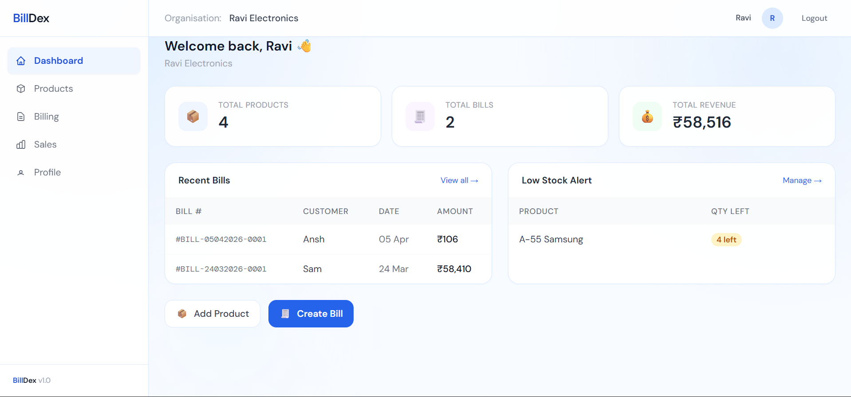
Project Snapshots
9

Slide 10
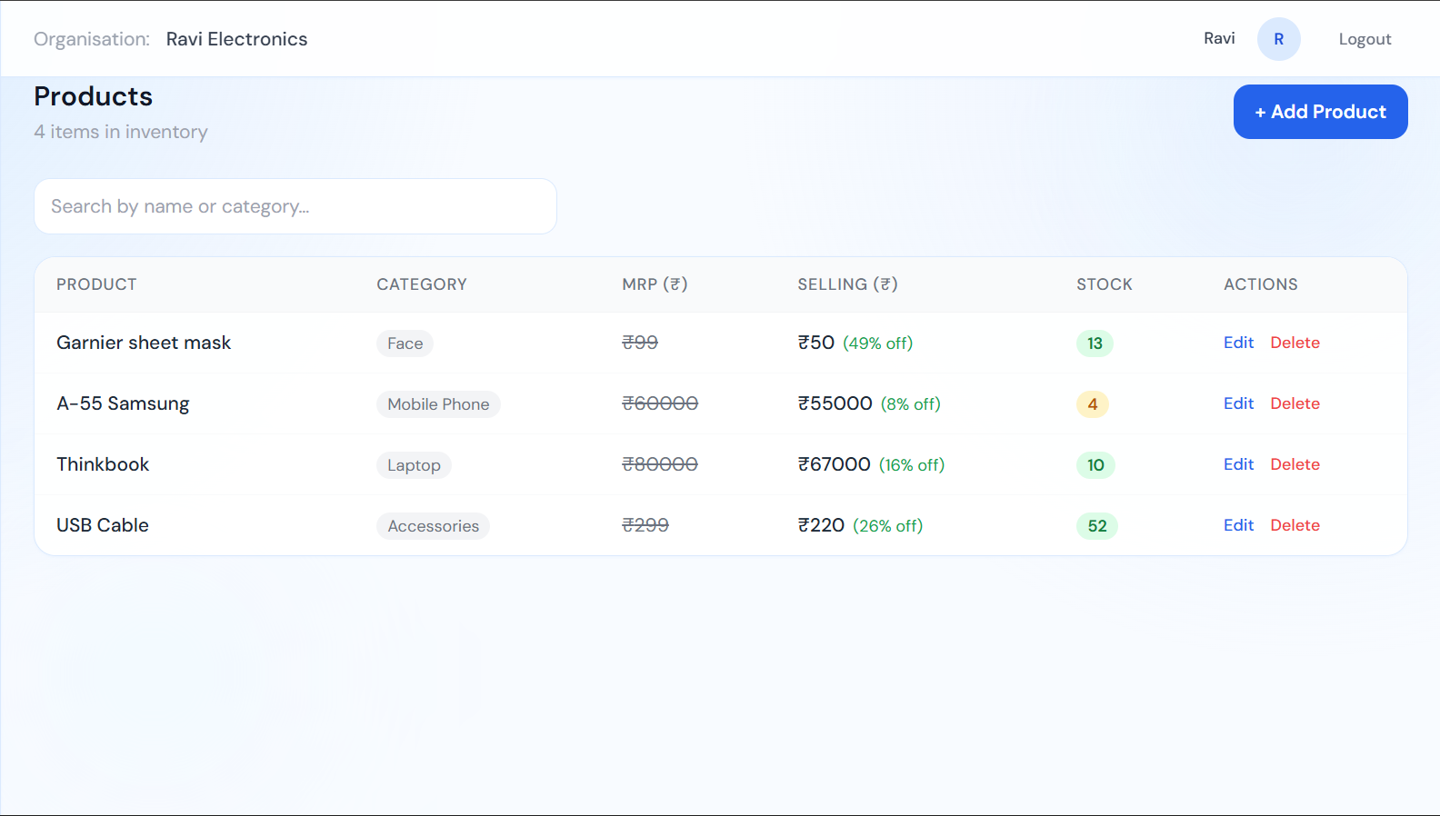
Project Snapshots
10

Slide 11
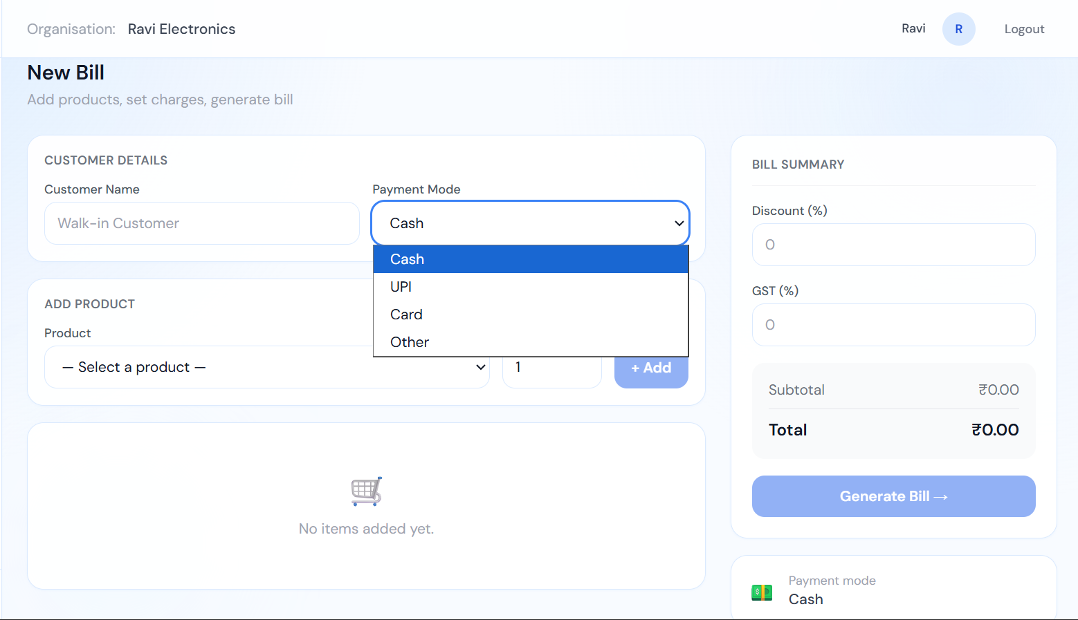
Project Snapshots
11

Slide 12
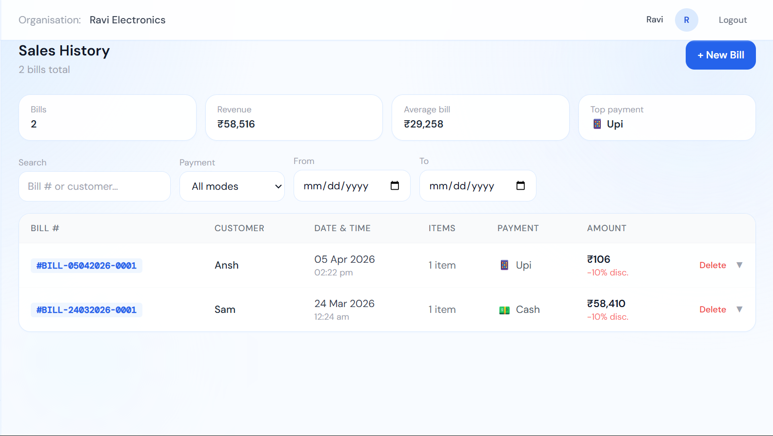
Project Snapshots
12

Slide 13
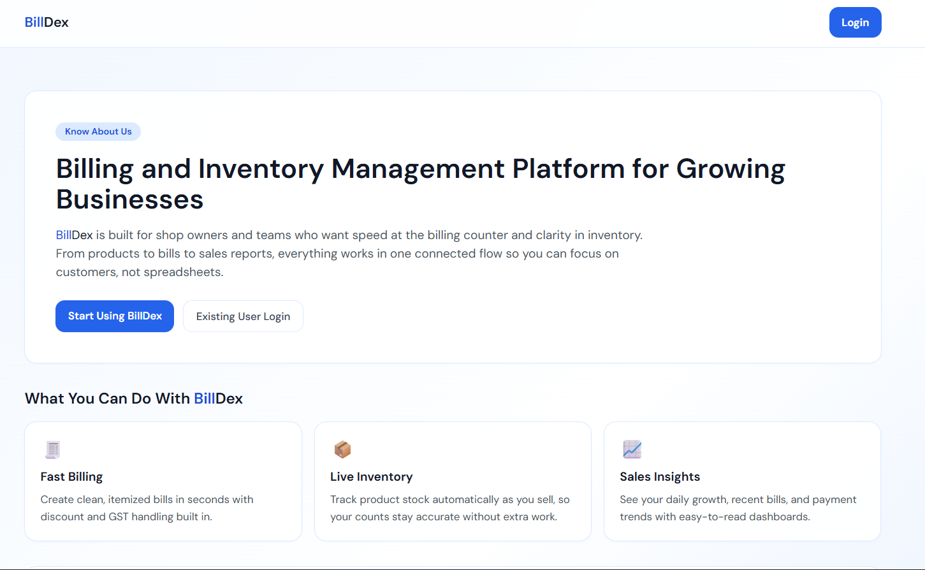
Project Snapshots
13

Slide 14
Conclusion
Billdex is a practical and efficient web-based platform designed to simplify billing and inventory management for small and medium-scale businesses. It provides a centralized system for handling product records, generating bills, tracking sales, and maintaining accurate stock levels. By automating routine business operations, Billdex reduces manual effort, minimizes errors, and improves overall efficiency.
The platform offers secure user access, organization-based data management, and a user-friendly dashboard for smooth daily operations. Features such as product categorization, smart billing, sales history, and automatic inventory updates make it a reliable solution for modern businesses. With a scalable MERN stack architecture and clean interface, Billdex serves as a valuable digital tool that helps businesses save time, stay organized, and manage growth effectively.
14

Slide 15
Future Scope
Advanced Analytics Dashboard: Introduce charts and reports for sales trends, top-selling products, and monthly business performance.
Invoice Export & Printing: Enable bill download in PDF format and direct invoice printing for customers.
Low Stock Alerts: Notify users when product quantity reaches a minimum threshold for timely restocking.
Search & Filter Features: Add advanced product search, category filters, and billing history filters for faster management.
Multi-User Roles: Support staff accounts with role-based access such as owner, manager, and cashier.
Cloud Deployment: Deploy the platform on cloud infrastructure for secure access, scalability, and real-time availability from anywhere.
15

Slide 16
References
MongoDB Documentation – MongoDB, Inc. (2026). Official MongoDB Documentation for database design, queries, and data management.
Express.js Documentation – Express.js Foundation. (2026). Official Express.js framework documentation for backend routing and API development.
React Documentation – React Team. (2026). Official React.js documentation for building dynamic and responsive user interfaces.
Node.js Documentation – OpenJS Foundation. (2026). Official Node.js documentation for server-side runtime environment and backend operations.
Tailwind CSS Documentation – Tailwind Labs. (2026). Official Tailwind CSS documentation for utility-first frontend styling and responsive design.
Mongoose Documentation – Mongoose Team. (2026). Official Mongoose ODM documentation for MongoDB schema modeling and database integration.
16

Slide 17
Thank You
17

